Slide 1
Infection Prevention at Seton Medical Center Harker Heights
There are 6 types of precautions:
Standard – used for every patient, every time and include gloves for contact with BSI and good hand hygiene
Contact - used for preventing the spread of bacteria parasites and viruses from one person to another from sources including draining wounds, rashes, diarrhea, lice, urine, blood, etc.
This category includes a subset category we use here at SMCHH called
      Contact-R: this is for enteric isolation (diarrhea) and includes Handwashing only upon exiting the room and the use of Clorox containing disinfection.

Slide 2
Infection Prevention at Seton Medical Center Harker Heights
Droplet – used for preventing the spread of germs caused by respiratory viruses and bacteria such as influenza, pertussis, pneumonia, meningitis, etc. Used in addition to contact precautions, the wearing of a mask and eye protection is to prevent spread of germs when an infected person talks, coughs or sneezes. Other people can become infected by breathing in the germs or getting them in their eyes.
  Enhanced Droplet Precautions– used for Covid 19 at SMCHH – N-95 masks required
Airborne – used to prevent the spread of germs through the air or dust. Examples include tuberculosis, measles, chickenpox, SARS, MERS-CoV, disseminated shingles (varicella/herpes zoster). Germs can remain in air or dust for a long time and spread far from you to others. Anyone who breathes in the germs can become infected. N-95 masks are used as well as contact isolation and good hand hygiene. Encourage the patient to cover the mouth and nose with a tissue when coughing or sneezing and to practice hand hygiene often.
Neutropenic – also known as Protective or Reverse isolation is used to prevent the spread of germs to the patient from outside sources when the patient’s immune system is compromised.

Slide 3
Infection Prevention at Seton Medical Center Harker Heights
Below is a table for precautions for selected infections and conditions. It is by no means a complete list. There is an additional list at each nurses station in the infection control book.
The list can also be found at:
https://www.cdc.gov/infectioncontrol/guidelines/isolation/appendix/type-duration-precautions.html
As a standard, any patient coming in with diarrheal stools should be questioned on how many per day. If there are more than 3 per day, or the patient has been admitted to a skilled nursing facility, they should be placed in enteric isolation and the physician notified.
All patients should have the required screenings completed. If any of the patients screen positive, please ensure the policy is followed for the specific screening (example: MRSA screening is positive, then the patient will need a MRSA nasal swab performed)
The Duration of illness of any patient may be dependent upon the infection, site and severity of illness. This may be decided on a case by case basis. Please ask the Infection Preventionist for guidance if you have any questions or concerns.

Slide 4
Infection Prevention at Seton Medical Center Harker Heights
Often, patients find themselves placed on “Isolation Precautions” and yet, they fail to receive an adequate explanation of why or what that entails.
Ensure any patient education regarding isolation is documented in Epic. This will help meet TJC requirements for educating the patient.
Questions should be answered at the time the patient is placed on isolation: why is the patient on isolation? How long can they be expected to be on isolation? Etc.
If you are unsure of the length of duration, please consult the physician or Infection Prevention.

Slide 5
Adding Isolation in Epic
Simply click on the add isolation when the alert is brought up when the chart opens or isolation icon on the patient dashboard and add the most appropriate type
Follow the guidelines in the isolation prompts. If you would like more information the CDC link with take you to the information page.
Floor Nurses may add isolation but cannot resolve an infection. Only Infection Prevention has the ability to resolve an infection.

Slide 6
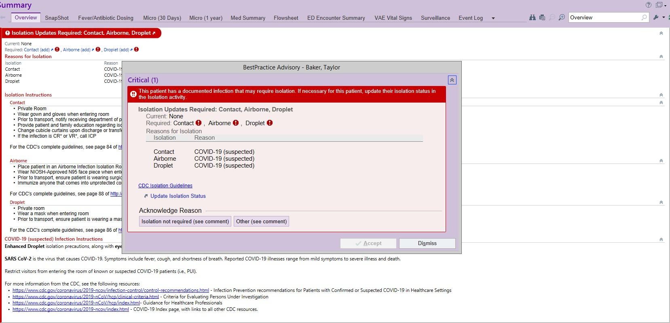
Adding Isolation in Epic
This will show if isolation is not assigned to an infections patient:

Slide 7
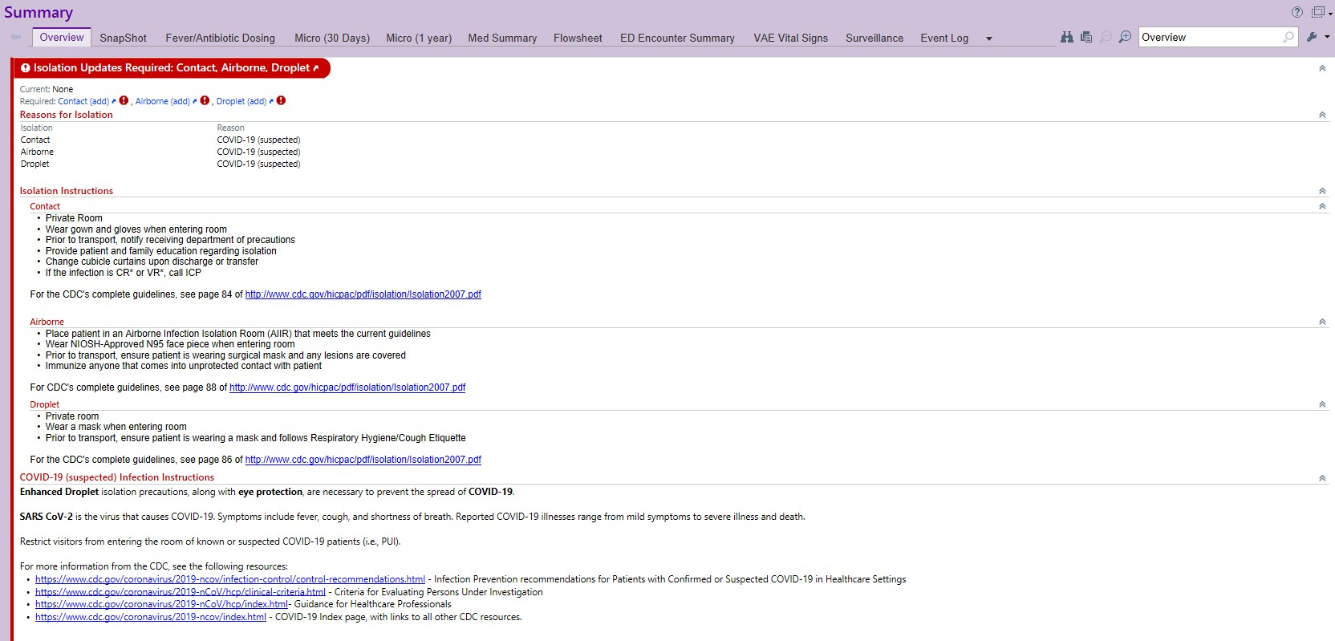
Adding Isolation in Epic
This will show if isolation is not assigned to an infections patient:

Slide 8
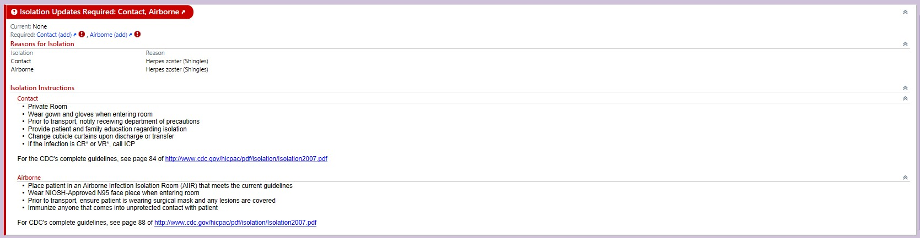
Adding Isolation in Epic
It will tell you what the infection is and what needs to be added:

Slide 9
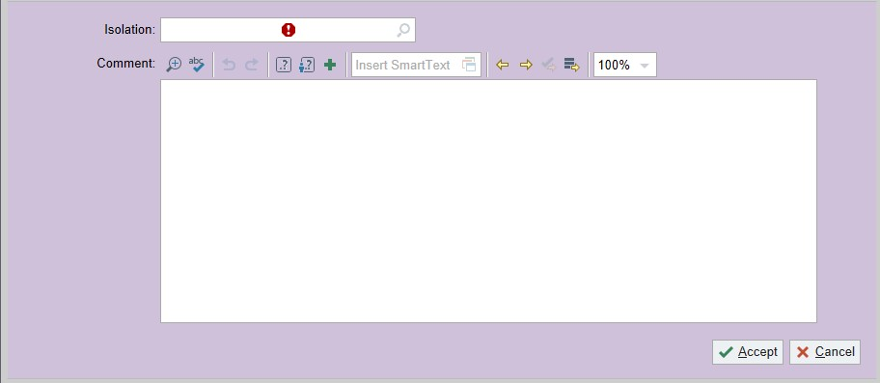
Adding Isolation in Epic

Slide 10
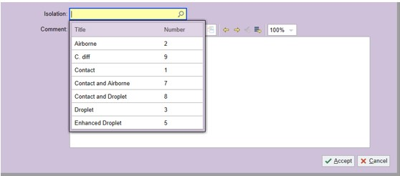
Adding Isolation in Epic

Slide 11
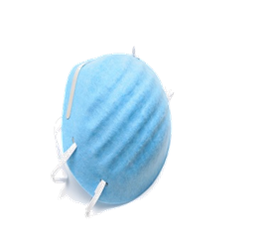
Airborne Precautions
Needs negative pressure room. (See next slide)
Caregiver must wear an n-95 mask, gown and gloves.
Signage on door to warn others of need for PPE
Limit visitors [no small children]; must wear mask
Door remains closed at all times
Dispose of PPE in anteroom or at doorway

Slide 12
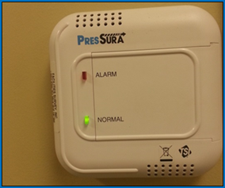

Airborne Isolation Room (“Negative Pressure Room”)
Airborne infection isolation room (AIIR) - also known as a negative pressure room.
Used to isolate patients with a suspected or confirmed airborne infectious disease.
SMCHH has 7 negative air flow rooms available for patient use:
Emergency Department Room 10
Surgery PACU Room 1
ICU Room 1
Med/Surg rooms 207 and 245
Women’s Center Room 101
Nursery Isolette Room
A control monitor outside the room is equipped with an indicator light.
When "on“, (green light is lit) active negative ventilation is occurring.
(It is not necessary to have an anteroom for airborne isolation, however a separate anteroom is available in rooms 207 and ICU Bed 1 and should be used as the only access into these rooms for isolation care.)
Only staff that have been fit tested by SMCHH are permitted in Airborne Isolation rooms.

Slide 13
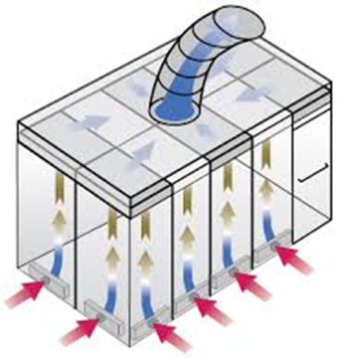
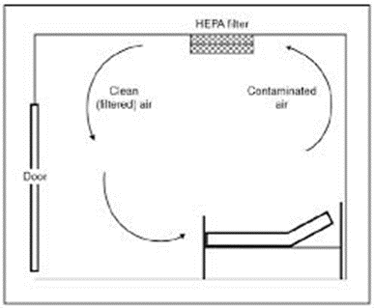
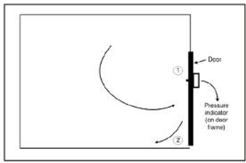
Airborne Isolation Room (“Negative Pressure Room”)
The Airborne Isolation rooms are always on; however, with the doors open, they will not be at the proper pressure. To return the room the correct negative pressure, pull the door shut.
By pulling the door shut, the higher differential in the room will cause the air to flow correctly in a negative pressure manner and thereby keep any possible germs out of the hallway.
A paper test is done regularly to test the Negative pressure rooms.

Slide 14
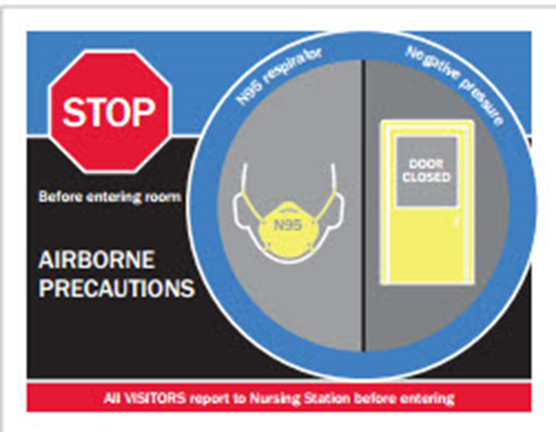
Infection Prevention at Seton Medical Center Harker Heights

