Slide 1
Medication, IVs and
Blood Transfusions

Slide 2
Medication Administration
Policies

Slide 3
Upon Admission
MUSTS
  Document patient’s Height, Weight, and Allergies
    Document weight in Kg
  Reconcile patient medications
    the physician must reconcile all medications and address deficiencies / discrepancies
    Utilize the pharmacist to provide opportunities to make recommendations to streamline medication therapies.

Slide 4
Medication Reconciliation
Complete upon arrival to unit
  Must be completed BEFORE the Pharmacy can fill prescription orders
  Tips to obtaining information from the patient
    BE THOUROUGH
      Ask the patient what they think the med is used for
      Ask what (any and all) over-the-counter or herbal meds are used
      Ask the patient when they took the last dose
    Watch for duplications
      Medication duplications
      Therapeutic duplications
    Watch for adverse reactions
    Ask the pharmacist to help on admission
      They are trained to interview on medication histories
      They can quickly catch duplications
      They can catch “side-effect” chasing

Slide 5
Who Can Administer Meds
  RNs GNs
    Restrictions
      Chemotherapeutic (only approved RNs)
  Student Nurses – under the supervision of RN
  PT – topical drugs related to treatment
  Radiology Tech – radiology drugs / agents
  CRRT, RRT – respiratory therapy meds
Everyone is Responsible for Education
  Provide Patient and Family education regarding potential side effects etc.

Slide 6
How to Administer
Use 2 identifiers
  Patient’s Full Name, Date of Birth
Verify drugs to be administered with order
  Order must be complete:
    Date / Time
    Drug Name
    Drug Strength
    Route
    Frequency
    PRN Qualifier (if necessary)
    Signature of Prescriber
  Order must conform to CMS rules and regulations
  Order must conform to The Joint Commission regulations

Slide 7
How to Administer (continued)
Refer to MAR to ensure dose is correct
  not contraindicated by
    Allergy
    Sensitivity
    Diagnosis
Use 5 Rights:
    Right Patient
    Right Drug
    Right Dose
    Right Route
    Right Time

Slide 8
Medication Orders
PRN Orders
  Qualifiers
    If a drug has only one indicator, then a qualifier is not needed
      Ambien 10 mg q hs prn
    If a drug has more than one indication, then a qualifier is required
      Tylenol 650mg q 4 hr. PRN headache
Hold Orders
  Are interpreted as discontinued
Titrate Orders
  Must include parameters both at lower limit and upper limits, when applicable to the drug

Slide 9
What Do You Do If….?
Refused Doses
  Return reusable drug to the Patient’s supply or ACCU-Dose.
  Destroy unusable refused drugs
  Document administration or refusal of drug
  Inform physician of patient refusal
Discontinued Meds
  Remove from the patient’s drug supply
  Return to the Pharmacy
Discharged patients
  Remove drugs
  Place in pharmacy pickup container or return to pharmacy

Slide 10
What Do I do In Case of A Drug Error or Adverse Reaction?
Report to attending physician
Complete a Variance Report
Report incompatibilities to the Pharmacy

Slide 11
Controlled Substance Discrepancy

Slide 12
Controlled Substance Discrepancies
All discrepancies will be reviewed and reconciled prior to the end of shift.
  All staff will remain on site until resolved
  Supervisor and Pharmacist will be notified
All discrepancy resolutions will be reviewed by the House Supervisor
  except in OR – reviewed by OR Director or Charge Nurse
If discrepancy can not be resolved, Director of Pharmacy, CNO, or the Administrator On Call will be notified immediately
  Drug Screens per hospital policy

Slide 13
Controlled Substance Wasting

Slide 14
Wasting Controlled Substances
Wastage of controlled substance
  Witnessed – by RN or physician
  Documented – by both parties in Accu-Dose
  Destroy wastage
    Liquids – waste in the Sharps Container
    Patches – fold (sticky side together) place in Sharps Container

Slide 15
IV Therapy – Adult / Pediatric
Peripheral
Central and PICC

Slide 16
Peripheral Site / Catheter Selection
Always choose the distal most site available based on
  Patient Condition
  Age
  Site Availability
  Medication to be infused
  Treatment to be administered
  Duration of infusion
Catheter Selection
  20 gauge for adults is typical
Use Alcohol Impregnated Port Protectors ( Swabcaps and CUROS tips) on all IV access ports and connectors

Slide 17
Peripheral IV Catheter/Site Monitoring
  Peripheral IV site can remain
    Exception
      IVs placed by EMS – must be replaced within 24 hours of site placement
      Adult patients that have limited venous access
  Dressing Change
    Every 96 hours (4 days)
      Sooner if needed
    Document on dressing
      Date
      Time
      Catheter size
      Initial

Slide 18
Pediatric Peripheral IVs
IV starts
  2 attempts / 2 RNs only – call physician for instructions
Site Selection
  Scalp veins may be used in infants less than 9 months of age
  Hands and arms for infants and older children
  Patients > 3 years of age – order required to initiate in feet
IV Tubing / Buretrols / Pumps
  All patients < 40 Kg require an IV pump AND a Buretrol with no more than 2 hours of IV fluids in the chamber
  IV meds are given via Syringe Pump
  All medication infusions MUST be check by 2 RN on patient less than 3 years of age

Slide 19
IV Catheter Site Monitoring
  Monitor for signs of complications – document in EMR
  Assess site
    for bleeding, redness, swelling, tenderness, induration and drainage
      Q 12 hours - saline lock
      Q 2 hours – continuous infusion
      Q 1 hour – pediatric
      With every IV med administration

Slide 20
ITRACE process for Assessing Sites
I - Illuminate – pt care area when lines are manipulated
T - Touch the line and Trace it from insertion (patient) to
point of origin
R - Perform Cognitive Review – purpose of IV, outcome,
2 patient identifiers used, etc
A - Act if difference in planned and desired outcome
C - Clarify and Correct – concerns that are expressed.
Correct any discrepancies before proceeding
E - Expect to use the ITRACE process each time a line is
accessed, manipulated or discontinued AND when
handoff to anther clinician.

Slide 21
When to Replace IV…
Fluid 24 hours
Tubing
  Primary and Secondary 96 hours
  TPN / PPN 24 hours
  Blood every 2nd unit
Saline Lock connectors 72 hours
Injection caps for PICC lines 7 days

Slide 22
When to Flush
Adult
Peripheral Catheters 3 ml NS
  Every shift
  Before and after all med administrations
    Use 100 ml NS bag for flush IV piggybacks, run through saline lock
Central Lines / PICC 10 ml NS
  Every 8 hours (all ports)
  Before and after all med administrations
Pediatric
Peripheral Catheters 2 ml NS
  Every 8 hours
  Before and after all med administrations

Slide 23
When to Change Dressings
  Transparent dressings every 7 days
  Gauze dressings every 2 days
  Change initial Central Line and PICC line dressing after 24 hours.
  Change any dressing sooner if it becomes damp, loosened, or visibly soiled.

Slide 24
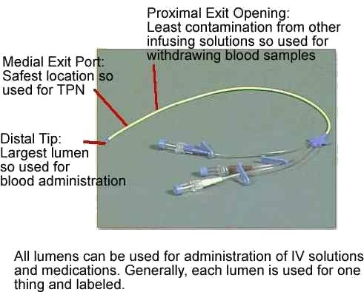
Central Lines
Types
  Non Tunneled
  Tunneled Catheter
  PICC line
  Implanted Port

Slide 25
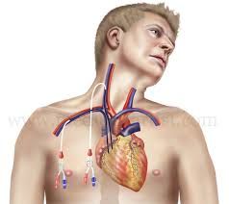
Central Lines – Non-Tunneled
Central Lines are IV access lines placed in the high flow, large centrally located veins of the body.
  Internal Jugular vein
  Subclavian Vein
  Femoral Vein
Used for long term IV Fluid administration, TPN, or if the patient does not have peripheral access
Inserted by the physician

Slide 26
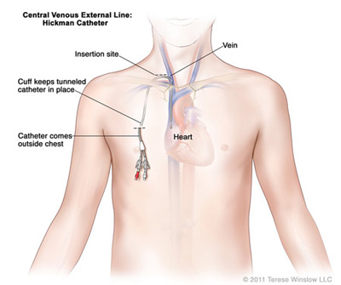
Central Lines - Tunneled
Brands
  Hichman / Broviac
  Groshong
Surgically inserted
Threaded under the skin
Manage like all other Central Lines

Slide 27
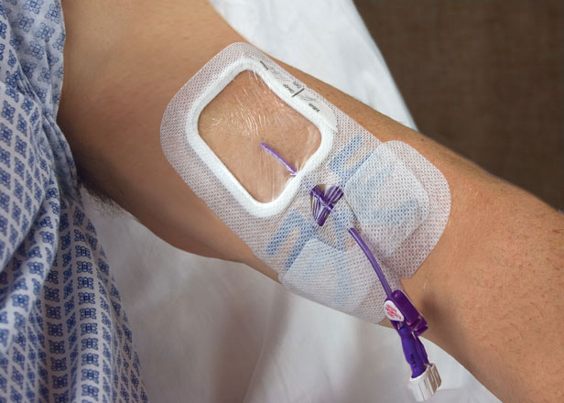
Central Lines - PICC
Used for moderate to long term need for fluids, antibiotics, etc
Can be inserted by trained RN
Usually placed in median cephalic, basilic or cephalic veins

Slide 28
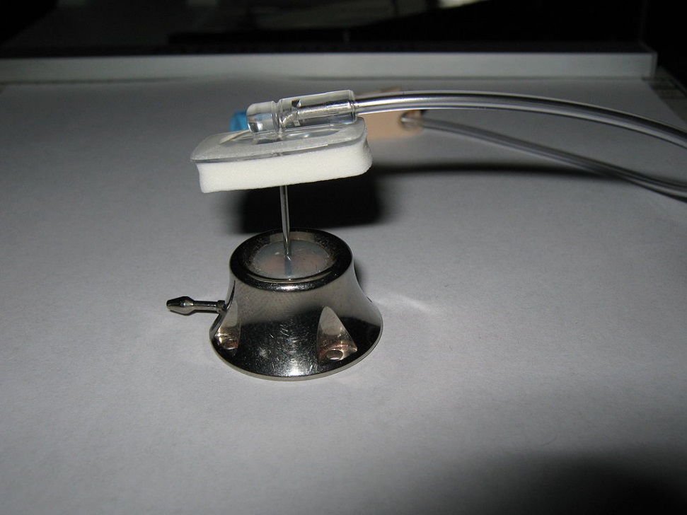
Implanted Ports
Implanted subcutaneously
Port-a-caths – most common brand
No dressing is required
  Exception – when accessed
Flushed with Heparin
Accessed with Huber Needle (non-coring)

Slide 29
PICC Line Maintenance
Flush
  every 8 hours
  10 mL NS
  With syringe ≥ 10 mL
  NEVER smaller
Dressing Change
  Initial – 24 hours
  Every 7 days thereafter
Assess site for bleeding, signs of infection with hourly rounds
Complications
  Occlusion or clotting
    USE PULSATION method with flush
  Mechanical phlebitis / Thrombosis
    Secure
  Catheter leak
  Accidental removal
    Measure length of catheter - awareness
    SECURE

Slide 30
Nurse Role with Central Lines
Initial - After Insertion
  Obtain Chest X-Ray after insertion
  Do not access the central line until placement has been verified. Obtain physician order to use
  Flush all lumens to maintain patency
  Monitor site for bleeding
  Assess breath sounds
  Assess circulation
  DOCUMENT insertion, site, dressing and flushing
Ongoing
  Flush each lumen
    q 8 hours
    before and after use
    10 ml NS
  Close clamps to each lumen when not in use
  Dressing changes
    Initial 24 hours after placement
    Thereafter – 7 days
  Monitor for infection

Slide 31
Medication Administration

Slide 32
  Most Common LASA Drugs Administered at SMCHH
Joint Commission Standard
ISMP’s List of Confused Drug Names
  http://www.ismp.org/Tools/confuseddrugnames.pdf
  cloNiDine clonazePAM
  diFlUcan diPRIVan
  DOPamine doBUTamine
  ePHEDrine EPINEPHrine
  hydrOXYine hydraALAZINE
  metFORMIN metroNIDAZOLE
MUCOmyst muciNEX
Solu-MEDROL Solu-CORTEF
Wellbutrin SR Welbutrin XL
Zestril zeTIA

Slide 33
Antibiotics
Administer the first dose of antibiotic ASAP:
  Within an hour of the order
  Call the pharmacist if times MUST be adjusted from standard times
  Rationale: studies show better efficacy
  Be aware of drugs requiring Peak and Trough for continued administration.
  Antibiotics requiring Peak and /or Trough
    Gentamycin and Vancomycin
      doses CANNOT be given less than 6 hours apart
      Both are Nephrotoxic
can lead to acute renal failure
Monitor Creatinine and BUN
    Gentamycin is also Ototoxic

Slide 34
Nursing Considerations for Vancomycin and Gentamicin
Vancomycin
  Monitor Creatinine and BUN
  Peak draws should be scheduled prior to the 4th or 5th doses
  Trough draws should be drawn 30 – 60 minutes before the dose is administered (during the day preferably)
  Administration
    Doses ≤ 2000mg should be given over 2 hours
    Doses 2000 – 2500mg should be given over 3 hours
Gentamicin
  Trough only
Obtain a 4 hour pre-dose draw / level before administering
the second dose
Target trough result – undetectable ≤ 0.5mcg/mL

Slide 35
Medication Administration: High Risk Drugs
Requires 2nd nurse verification upon administration
  Documentation on MAR
Which drugs are HIGH RISK? Think “PINCH”
  P Potassium
  I Insulin
  N Narcotics (high concentration)
  C Chemotherapy
  H Heparin

Slide 36
PCAs – Patient-Controlled Analgesia
Must be ≥ 6 years of age to use a PCA
Requires 2 RNs to
  initiate, set up, change syringes and discontinue
Monitoring clinical data – upon initiation
  Every 15 minutes X 4
  Every 30 minutes X 4
  Every 4 hours thereafter

Slide 37
IV Fluids

Slide 38
Isotonic IV Fluids
  Similar to plasma
  Remains within the extracellular compartment
  Increases intravascular volume
  Examples:
    0.9% NS
    lactated Ringers
    D5W - is isotonic but becomes hypotonic and causes fluid to shift into cells
  Uses:
    Volume Deficit: Hemorrhage, severe vomiting/diarrhea, heavy drainage from GI suction, wounds
    Shock
    Mild hyponatremia
    Metabolic acidosis
    Resuscitation efforts
    ONLY fluid used with administration of blood products

Slide 39
Hypotonic IV Fluids
Have a lower concentration of solutes (electrolytes)
Lowers serum osmolality within the vascular space causing fluid to shift from intravascular space to intracellular and interstitial spaces
Examples:
  0.45% NaCl
Uses:
  Hypernaturemia
  Diabetic ketoacidosis
NEVER give to patients
    At risk for increased ICP (may exacerbate cerebral edema)
    Liver disease
    Trauma
    Burns

Slide 40
Hypertonic IV Fluids
Have a higher osmolarity than plasma
  Draws water out of the intracellular space
  Increases extracellular fluid volume
Examples
  D5NS
Used as a volume expander
  Severe hyponatremia
  Cerebral edema
Precautions
  Potential for causing intravascular fluid volume overload and pulmonary edema
  Should only be administered in high acuity areas with constant surveillance for potential complications

Slide 41
Parental Nutrition

Slide 42
TPN / PPN
TPN – Total Parental Nutrition
  Must be administered through a Central Line
  Contains:
    Proteins
    Carbohydrates
    Lipids (SMCHH administers Lipid separately)
PPN – Partial Parental Nutrition
  Can be administered through a Central Line or Peripheral line
  Contains
    Proteins
    Carbohydrates

Slide 43
TPN / PPN
Uses
  Patients with non-functioning GI tract
  Patients who need complete bowel rest
Central Line should not be used for anything thing but the TPN / PPN
Tubing changed - every 24 hours
Dressing changed / labeled with date, time and initials – every 48 hours
Infusion – start slowly – 50% of calculated requirement
Insulin will be added to bag
  Monitor Glucose level regularly (q 6 hours until stable)
  Supplement insulin via scale as needed

Slide 44
IV Drips:
Lasix, Dopamine, Dobutamine

Slide 45
Lasix (FUROSEMIDE)
Diuretic used in the treatment of
  CHF
  Pulmonary Edema
  Acute Renal Failure
Mechanism of Action
  Loop diuretic
  Inhibits reabsorption of Na+ and Cl- at the proximal and distal renal tubules and Loop of Henle.
  Decreases water reabsorption

Slide 46
Lasix (FUROSEMIDE)
Administration
  Oral
  IV push
  Continuous IV:
    Check for compatibility with other IV drugs
    Check to ensure patient has a functioning IV site
    Prepared in pharmacy, a 1:1 mixture(1 mg= 1 ml)

Slide 47
Lasix (FUROSEMIDE)
Nursing Implications
  Vital signs q4h
  Daily weights
  Monitor urine output q4h
  Daily labs: Serum electrolytes, BUN/Cr, and CBC
  Monitor for muscle cramping
  Monitor for hearing loss
  Monitor telemetry rhythm as per remote tele protocol
  Obtain ECG as ordered

Slide 48
Heparin Infusion
Anticoagulant used in the treatment of:
  Deep Vein Thrombosis
  Pulmonary Embolism
  Atrial Fibrillation
  Acute Coronary Syndrome
Mechanism of Action
  Inhibits the mechanisms that induce the clotting of blood and the formation of stable fibrin clots at various sites in the normal coagulation system.

Slide 49
Heparin Infusion
Nursing Implications
  Verify MD order for infusion and protocol
  Notify MD if other anticoagulant therapy is not discontinued with Heparin infusion order (eg/ Lovenox, Arixtra, subQ Heparin)
  Obtain baseline labs: CBC, PTT, INR
  Obtain 2 large bore IV sites, if possible
  Two nurses must verify initial bolus dose and rate
  PTT 6 hours after every dose change
  PTT every 6 hours until 2 consecutive PTTs are in therapeutic range, then order PTT Q24H
  Adjust Heparin Infusion according protocol

Slide 50
Heparin Infusion
Contraindications
  Uncontrolled, active bleeding
  Known history of Heparin Induced Thrombocytopenia
  Development of thrombocytopenia while receiving Heparin therapy
Administration at SMCHH
  Premixed from Pharmacy
  25,000 units in 500ml of D5W
  Weight Based Adjustment
  Refer to Heparin Protocol (Public Drive, Nursing Protocols Folder)
Check for compatibility with other IV drugs
Check to ensure patient has a functioning IV site

Slide 51
Heparin Infusion
Nursing Implications - CONTINUED
  Two nurses must verify adjustment of the drip after each PTT is reported
  Monitor IV sites for bleeding
  Monitor for hematuria and bloody stools
  Monitor sites following lab draws
  Monitor daily CBC and PTT as per protocol
  Notify MD of obvious bleeding, drop in H&H, or platelet count < 100, 000.

Slide 52
Heparin Infusion
Education
  Educate patient and family on
    medication,
    rationale for use
    monitoring for signs and symptoms of bleeding
Inform ancillary staff that patient is receiving Heparin (Respiratory, Lab, PT/OT, etc.)

Slide 53
PCA

Slide 54
PCA – Patient Controlled Anesthesia
Nursing Assessment
Assess
  Vital Signs
  Pain
    Sedation level
  Respirations
    rate
    quality of respirations
  O2 saturation
Document
  Upon initiation, event or deterioration
    q 15 minutes X 1 hour
    q 1 hour X 4 hours
    q 2 hours
  After every program adjustment, dose change
    q 1 hour X 4 hours
    q 2 hours
  After every setting change
  At change of shift
USE 2 RNs – to Assess and Document

Slide 55
Nursing Assessment of Patients with PCA
Respirations –
  Respiratory Rate
    Count for 30 seconds
    If less than 12 per minute – count for a full minute
    If less than 10, discontinue PCA and CALL the provider
  Quality: Depth, Ventilatory Effort, Sound
Pain
  Use the Pain Assessment Scale
  IF unrelieved, NOTIFY the physician
Sedation
  Use Richmond Agitation Sedation Scale
  IF excessive or increasing level of sedation, not controlled by rate adjustment - STOP the infusion
Pulse Oximetry Monitoring
  Assess on room air
  Prudent assessment for those with Hx of Sleep apnea, Obesity, over 65 years of age
  If desaturation noted – STOP the infusion

Slide 56
Blood Transfusions

Slide 57

The Physician Order
The physician orders must contain:
  Order to Type and Screen
  Order specifying blood product(s)
  Order to Transfuse (Nursing Order)
      Do not transfuse without a written order
      “Transfuse (or Give) X units of X blood product.”
      Order may also contain a qualifier
      “ for HGB below 8”

Slide 58
Transfusion Consent
Physician – explains the risks and benefits of blood administration and gains the patients verbal consent.
RN – has the patient sign the “Informed Transfusion Consent / Refusal Form”
  RN witnesses signature of patient

Slide 59
Release of Blood Product
RN takes Transfusion Release Order to the Blood Bank
Two person verification is completed in the Blood Bank
  RN
  MT – Blood Bank
Unit is released to the RN

Slide 60
Equipment / Preparation
Patent IV site with a 20 gauge IV catheter (or larger)
Y-tubing
0.9% NS
Alaris Pump
Administer pre-transfusion meds
VS – 30 minutes prior to administration start time

Slide 61
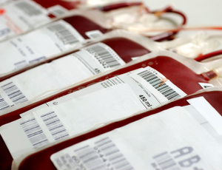
Transfusion Verification
2 Licensed staff will verify
    (2 RNs, RN and MD / Perfussionist / CRNA)
  physician order
  patient consent signed and in medical record
  Bar codes scanned in EPIC - patient information and blood product

Slide 62
Administration Policy
Infusion Rate
  100 ml / hr X 30 minutes
  May increase to 150 / hr after first 15 minutes if free of S/S of reaction
Vital signs
  Every 15 minutes X 2
    Nurse must stay with the patient for the first 15 minutes of transfusion
  Every hour X 3 or until transfusion is completed
  Post transfusion
    If more than one unit is transfused, the post transfusion vital signs following the last unit may be utilized for the next transfusion unless greater than 30 minutes has elapsed.
Nothing is given via site of blood transfusion
Blood must infuse within 4 hours

Slide 63
Transfusion Reactions
Symptoms:
Flushing
Itching
Urticaria, hives
Asthmatic wheezing
Laryngeal edema
Anaphylaxis
Chills and fevers
Headache
Anxiety
Vomiting; diarrhea
Marked hypotension
Hemoglobinuria
Hemoglobinemia
Bleeding
Acute renal failure
Tachycardia, tachypnea

Slide 64
Transfusion Reactions
If a transfusion reaction is suspected:
  STOP blood immediately
  Disconnect blood tubing at the IV angiocath
  Keep the IV site open with saline
  Consider calling a Rapid
  IMMEDIATELY call the physician and the laboratory.

Slide 65
Transfusion Reaction Workup
Record time of reaction and any nursing actions taken.
  Mark any symptom occurring during or after blood transfusion. Do not circle any symptom present prior to blood transfusion.
Re-verify all identifying information
  on the blood container
  attached tag
  patient ID bracelet
  in the electronic medical record
Send blood bag and filter set to the laboratory.
Order transfusion reaction work-up in order entry.
  Continue vital signs.
  Begin time specific I&O sheet.
  Collect a urine specimen one hour after reaction has taken place. Label specimen "Blood Reaction" and send it to the laboratory.
Complete a Variance Report.

Slide 66
Mass Transfusions
For hemorrhaging patients with S/S of hypovolemic shock and has a physician order to initiate the “Massive Transfusion” protocol
Requires
  Physician order
  RN notify the Blood Bank and House Supervisor on the initiation
  Type / screen / cross match (if not already done) BEFORE infusion
  Blood Bank will create 2 transfusion packs:
    One for RBC and FFP (cold) with 4 units of each RBC and FFP
    One for Platelets and Cryo (room temperature) 1 unit platelets, 2 cryo units)
House Supervisor will be primary contact with Blood Bank as long as protocol is in effect

Slide 67
Mass Transfusions
Administration
  Use the Rapid Infuser or pressure bag
  Administer wide open - do not use a pump
  Vital signs documented every 5 minutes
  Lab specimen draw with each blood pack for CBC, PT, PTT and Fibrinogen
Keep patient warm
  Increase room temperature to 80 degrees
  Cover patient with Bear Hugger (if possible) or warm blankets
  Use Level 1 fluid warmer
  Use warm irrigation fluids when applicable

Slide 68
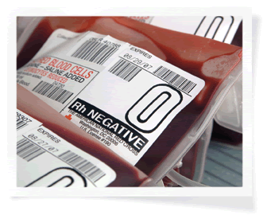
Emergency Transfusions
  The Physician must sign an Emergency Transfusion Request to obtain the un-crossmatched units.
  Each blood bag will be tagged with UNCROSSMATCHED BLOOD EMERGENCY RELEASED PRODUCT IDENTIFICAITON TAG
  Document on tag:
      Infusion start time
      Infusion stop time
      Volume infused
      Whether s/s of transfusion reaction
      were noted
  Indentification tag
    Original in patient chart
    Copy to Blood Bank

Slide 69
EMERGENCY TRANSFUSIONS
Emergency release of blood is permitted in the following high risk areas:
  ICU
  ED
  OR
  LABOR and DELIVERY

Slide 70
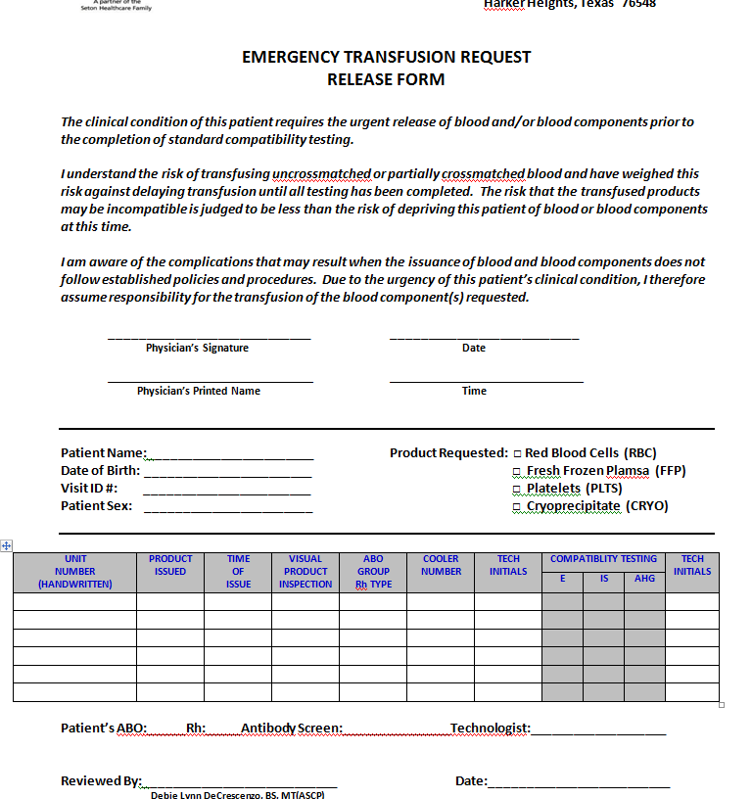

Slide 71
Emergency Release ID Tag

Slide 72
Blood Bank Tips
1. BE PREPARED!!----get comfortable with the details before the emergency!
- Know where to find and how to use…..
a. nursing transfusion policy/ procedure
b. blood administration forms
c. transfusion reaction forms
- Keep meticulous records during massive transfusion
(include chronological start/ stop times for each product and lab draw times)
- Be familiar with location and procedure for Rapid Infuser in emergencies
**Tip-- All products can be run wide open simultaneously through Rapid Infuser
in emergencies
- Visit the blood bank for a practice run with Blood Bank Director Debbie
2. When unexplained excessive bleeding…suggest the Coag Panel
3. Confirm T&C ordered minimum 1 hour prior to anticipated use {ex: scheduled C/S}
**Allow > time for pts with known transfusion history or antibodies
4. When in doubt, call and ASK!!!
Blood bank bench—6301, General Lab—6294, Lab Sup—6295, Dr. H—6303

Slide 73
QUESTIONS?????

