Slide 1
LET’S TALK ABOUT WOUND CARE
Identifying key points during the skin assessment
Understanding the steps to take when a wound is present

Slide 2
SKIN ASSESSMENT
The RN must thoroughly assess the skin of all admitted patients with the focus of identifying pressure related wounds present upon admission.
WHY?
If we don’t catch an existing wound upon admission, it is seen that we caused the Pressure Injury.
Stage III, Stage IV, and Unstageable Pressure Injuries that were not documented upon admission are reported as an Hospital Acquired Pressure Injury.

Slide 3
EFFECTIVE SKIN ASSESSMENT
How can you make a skin assessment effective?
Visual inspection from head to toe
Anterior, Posterior, Left Side, Right Side… EVERYWHERE!
Remove clothing
Spread skin folds
Thoroughly inspect all bony areas
Back of head, shoulder blades, elbows, sides of hips, coccyx, sacrum, heels, between knees, ankles

Slide 4
BRADEN SCALE REVIEW
Complete Braden Scale Score
Upon Admission
Each Shift
The Braden Scale Score is reflective of that current moment.
Adjust interventions, update the Plan of Care, communicate to team of changes, DOCUMENT.
Lower Braden Score = lower level of function = higher risk for pressure injury

Slide 5
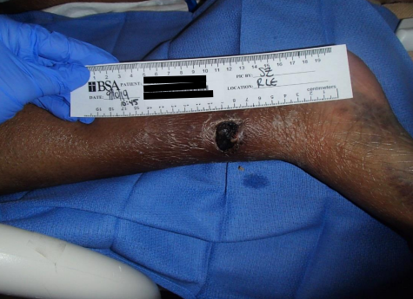
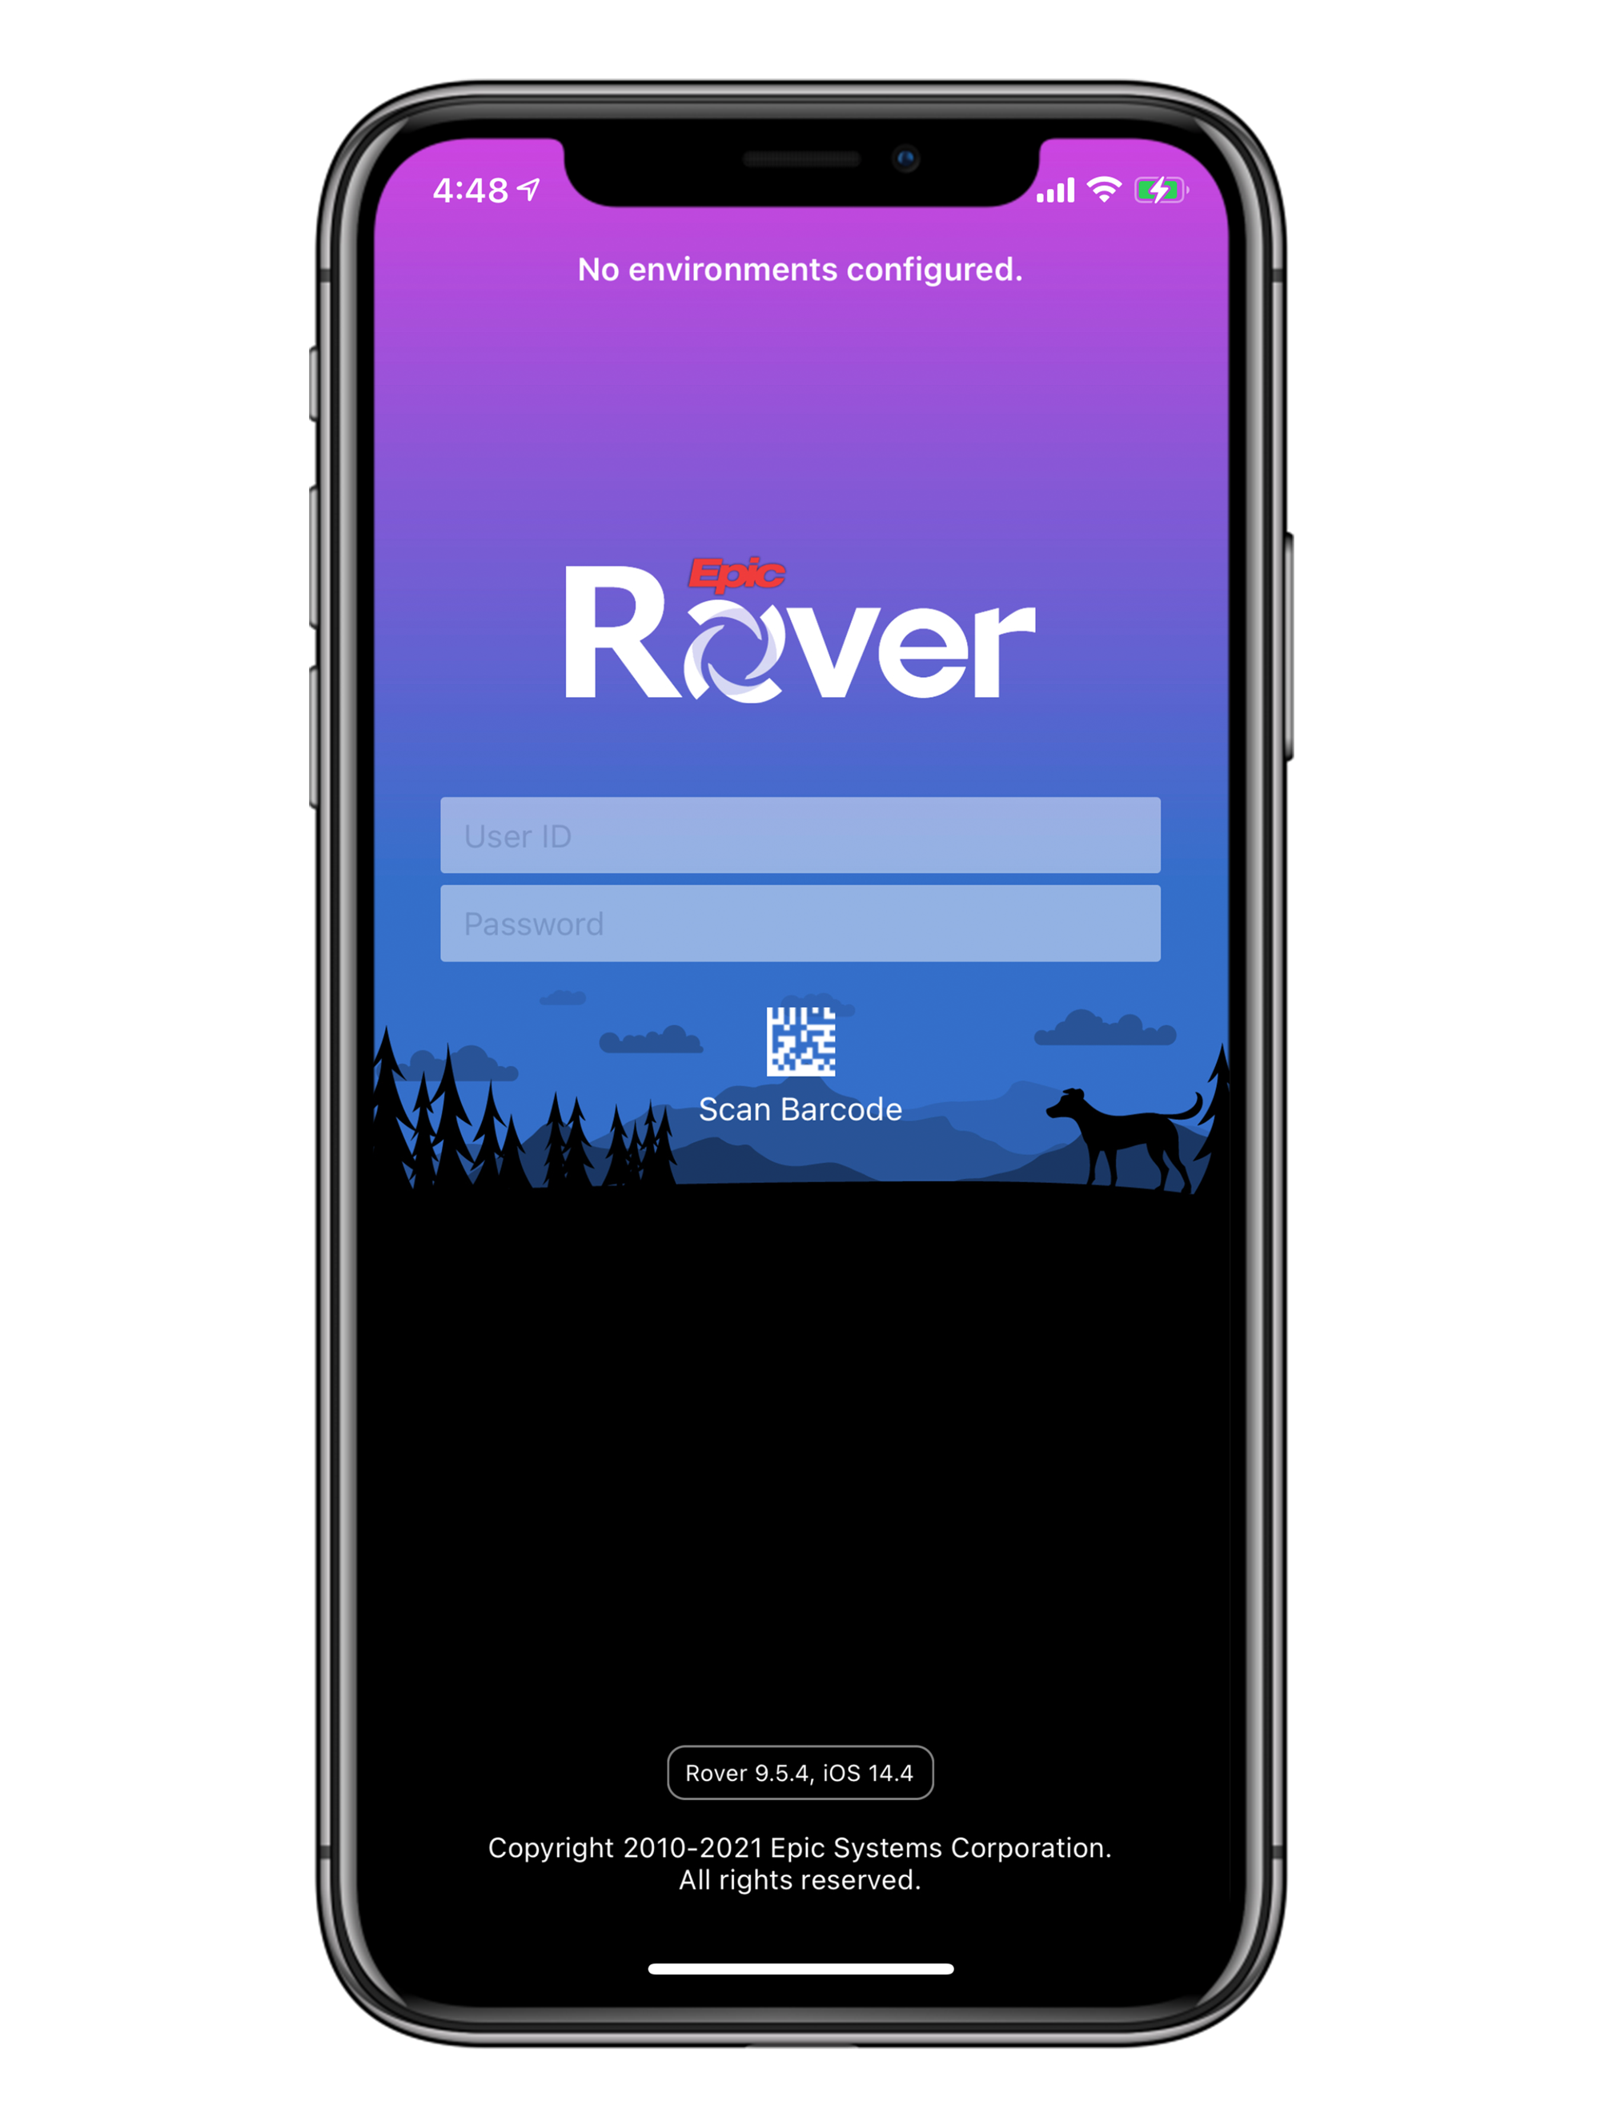
STEPS UPON DISCOVERY
PHOTOGRAPH OF WOUND
Include:
Measuring guide
Patient label
Location of wound
Date
Your initials

Slide 6
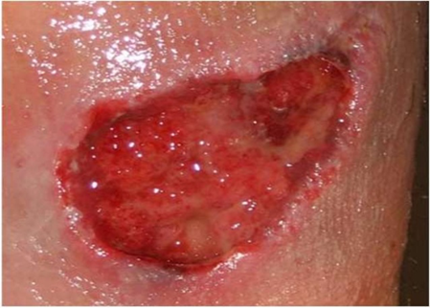
NEXT STEP UPON DISCOVERY
DOCUMENTATION
Describe what you see
Location
Size (Length, Width, Depth)
Wound Bed
Peri-wound
Drainage
Odor

Slide 7
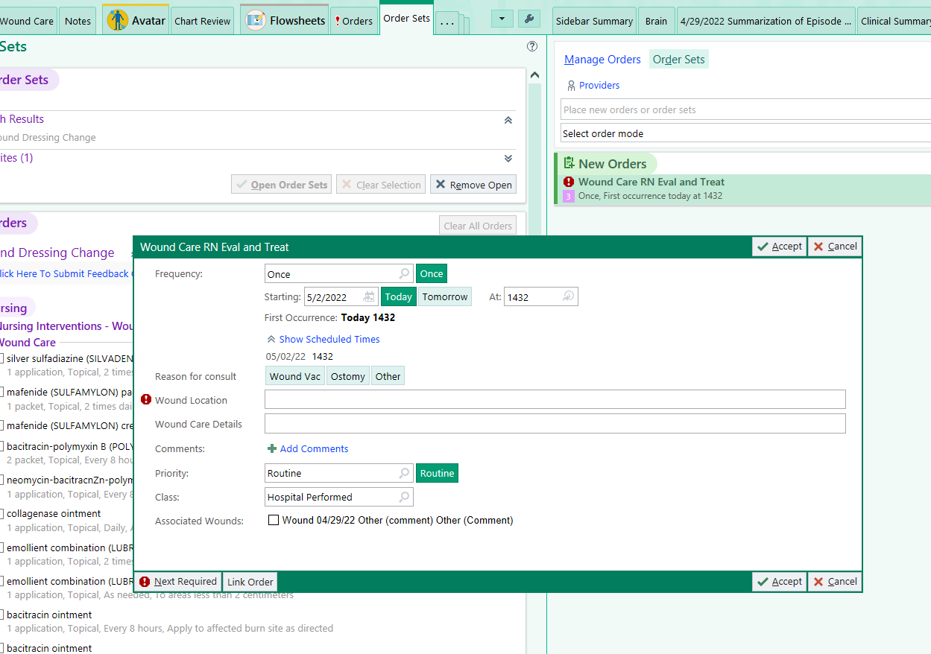
NEXT STEP UPON DISCOVERY
ORDER WOUND CARE CONSULT
*** If a Wound Care Consult is not ordered, the
Wound Care Nurse will not know your patient has
a wound.

Slide 8
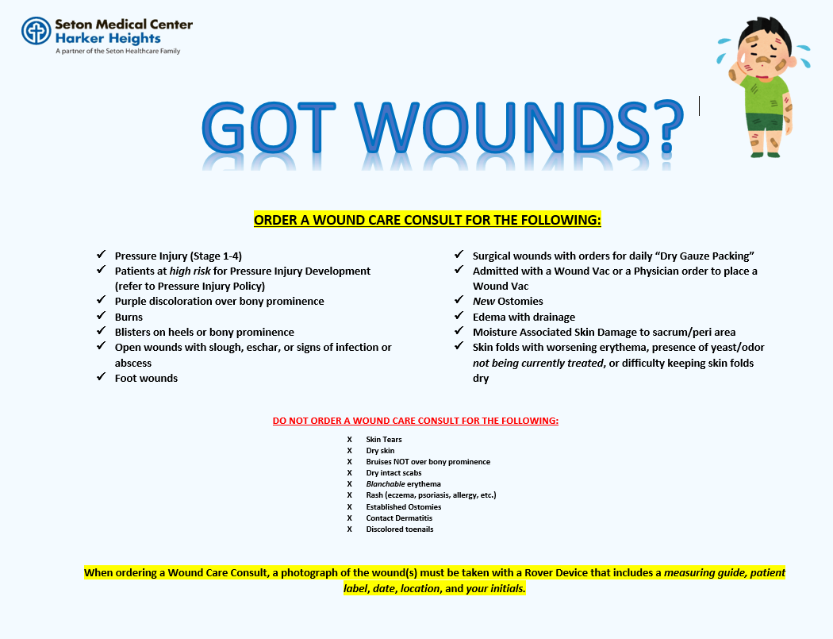

Slide 9
QUESTIONS?

